Slide 1

HR ANALYTICS DASHBOARD FOR ATTRITION

Slide 2
Introduction
Employee attrition refers to the natural process of employees leaving an organization for various reasons, such as resignations, retirements, terminations, or any other form of departure. It is often measured as a percentage or rate reflecting the number of employees who have left the organization over a specified period, typically annually, relative to the total workforce.

Slide 3
Methodology
The dataset Contain information of 4410 Rows and 29 Columns.

Slide 4
Data Exploration
Data exploration is the first step of data analysis and it is used to explore and visualized data to take any necessary actions. Based on our understanding of the data we can go with the appropriate data cleaning.

Slide 5
Data Importing
To Import the data into Power BI, Let’s start with the Get Data option under the home tab. As this is a CSV file, select the Text/CSV option from the drop-down list and the select the file named. After selecting the file, data will be displayed Click on Load and save data.

Slide 6
Data Cleaning
We need to clean the data with the help of Power Query Editor.
To open the Power Query Editor by clicking on Transform
Data under the Home tab and go to Power Query Editor.
In Power Query Editor, go to the View tab, enable Column Distribution, Column Quality and Column Profile. It will help you to find out missing values, any data errors, any data type mismatch, any outliers.
Using Get data option, CSV file is loaded into Power Bi Desktop.
Transformed Data to chuck values in CSV file.
There were 110 Null Values are there in our data set.
After removing Null values there are total 4300 rows.

Slide 7
Data Visualization
I have used Power BI tool to visualize the data available to gain meaningful insights and better understand the dataset. I have used different visualizations like bar graphs, line graphs, Cards, Mattrix,Donut chart and Slicer which are available in the tool.

Slide 8
Analysis
Created KPI Card to know Total employee, Attrition, Attrition Percentage, Average age of employees, Average Monthly income, Average Years in company, Average distance from Home.
Used Donut Chart to create Education Field wise Attrition.
Created Column chart to know job role by Attrition.
Used Matrix to calculate job role wise Attrition by Employee Satisfaction.
Created Line Chart where High Attrition happening within 1 to 5 years.
Used 3 slicer for Gender, Department and marital Status

Slide 9
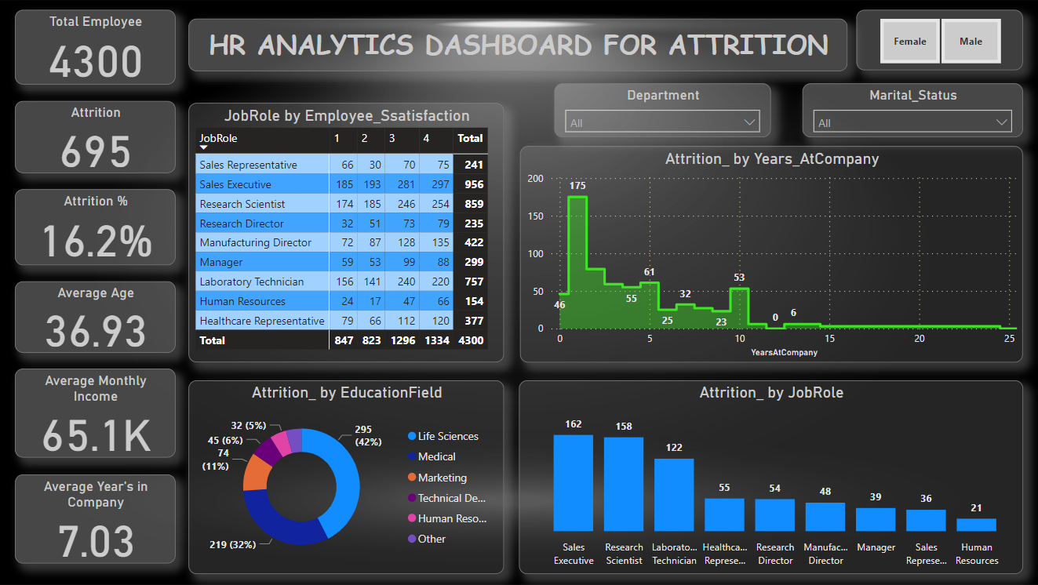

Slide 10
Thank You

